Slide 1

Above All

Slide 2
G/ C
G C D G
Above all powers, above all Kings
C D G
Above all nature, and all created things
Em D C G
Above all wisdom, and all the ways of man
Am D G
You were here before the world began

Slide 3
C D G
Above all kingdoms, above all thrones
C D G
Above all wonders this world has ever known
Em D C G
Above all wealth and treasures of the earth
Am C B
There's no way to measure what You're worth

Slide 4
G Am D G
Crucified, laid behind a stone
G Am D G
You lived to die, rejected and alone
Em D C G
Like a rose, trampled on the ground
Am G C D G
You took the fall, and thought of me Above all

Slide 5
C D G
Above all powers, above all Kings
C D G
Above all nature, and all created things
Em D C G
Above all wisdom, and all the ways of man
Am D G
You were here before the world began

Slide 6
C D G
Above all kingdoms, above all thrones
C D G
Above all wonders this world has ever known
Em D C G
Above all wealth and treasures of the earth
Am C B
There's no way to measure what You're worth

Slide 7
G Am D G
Crucified, laid behind a stone
G Am D G
You lived to die, rejected and alone
Em D C G
Like a rose, trampled on the ground
Am G C D G
You took the fall, and thought of me Above all
Play x2

Slide 8
Em D C G
Like a rose, trampled on the ground
Am G C D G
You took the fall, and thought of me Above all
END

Slide 9
God Bless America

Slide 10
C/G/
C/G/D/G
G D
God bless America,
G
land that I love
G7 C G
Stand beside her and guide her,
G D7 G
thru the night with a light from above

Slide 11
D G
From the mountains, to the prairies,
D D7 G
to the oceans white with foam
C G
God bless America,

Slide 12
C G D G
my home, sweet home
C G
God bless America,
C G D G
my home, sweet home.

Slide 13
G D
God bless America,
G
land that I love
G7 C G
Stand beside her and guide her,
G D7 G
thru the night with a light from above

Slide 14
D G
From the mountains, to the prairies,
D D7 G
to the oceans white with foam
C G
God bless America,

Slide 15
C G D G
my home, sweet home
C G
God bless America,
C G D G
my home, sweet home.
END

Slide 16

Praise To The Lord The Almighty

Slide 17
G Am Em
Praise to the Lord, the Almighty, the King of creation
G Am Em
O my soul, praise Him, for He is thy health and salvation
C D
All ye who hear, now to His temple draw near
C D G Am Em C
Praise Him in glad adoration

Slide 18
G Am Em
Praise to the Lord, Who o’er all things so wondrously reigneth
G Am Em
Shelters thee under His wings, yea, so gently sustaineth
C D
Hast thou not seen how thy desires e’er have been
C D G Am Em C
Granted in what He ordaineth?

Slide 19
G Am Em
Praise to the Lord, who doth prosper thy work and defend thee;
G Am Em
Surely His goodness and mercy here daily attend thee;
C D
Ponder anew what the Almighty can do,
C D G Am Em C
If with His love He befriend thee

Slide 20
G Am Em
Praise to the Lord, O let all that is in me adore Him
G Am Em
All that hath life and breath, come now with praises before Him
C D
Let the Amen sound from His people again
C D G Am Em C
Gladly for aye we adore Him

Slide 21
G Am Em
Praise to the Lord, the Almighty, the King of creation
G Am Em
O my soul, praise Him, for He is thy health and salvation
C D
All ye who hear, now to His temple draw near
C D G Am Em C (x2 end in G)
Praise Him in glad adoration
END

Slide 22
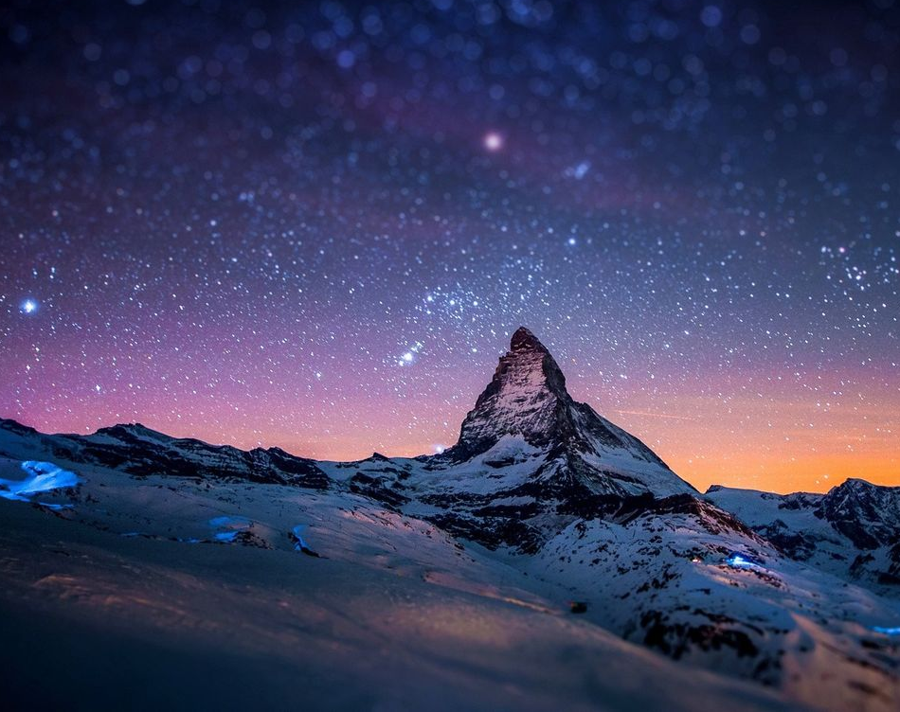
Goodness of God

Slide 23
C F C
I love You Lord Oh, Your mercy never fails me
G Am F Gsus G
All my days, I've been held in Your hands
Am F
From the moment that I wake up
C G Am
Until I lay my head
F G Csus4 C
I will sing of the goodness of God

Slide 24
F C
All my life You have been faithful
F C G
All my life You have been so, so good
F C G Am
With every breath that I am able
F G Csus4 C
I will sing of the goodness of God

Slide 25
C F C
I love Your voice You have led me through the fire
G Am F Gsus4 G
In my darkest night, You were close like no other
Am F
I've known You as a father
C G Am
I've known You as a friend
F G C
I have lived in the goodness of God

Slide 26
F C
All my life You have been faithful
F C G
All my life You have been so, so good
F C G Am
With every breath that I am able
F G Csus4 C
I will sing of the goodness of God

Slide 27
C F G C
Your goodness is running after, it’s running after me
C F G C
Your goodness is running after, it’s running after me
C F
With my life laid down, I’m surrendered now,
G Am
I give You everything
C F G C
Your goodness is running after, it’s running after me

Slide 28
F C
All my life You have been faithful
F C G
All my life You have been so, so good
F C G Am
With every breath that I am able
F G Am
I will sing of the goodness of God
F G Csus4 C
I will sing of the goodness of God
END

Slide 29
Amazing Grace

Slide 30
G C G
Amazing Grace how sweet the sound
G D
That saved a wretch like me
G C G
I once was lost but now am found
G D G
Was blind but now I see

Slide 31
G C G
T'was Grace that taught My heart to fear
G D
And Grace, my fears relieved
G C G
How precious did that Grace appear
G D G
The hour I first believed

Slide 32
G C G
Through many dangers Toils and snares
G D
I have already come
G C G
’Tis grace hath brought me safe thus far
G D G
And grace will lead me home

Slide 33
G C G
The Lord has promised good to me
G D
His Word my hope secures
G C G
He will my Shield and Portion be
G D G
As long as life endures
END

